Slide 1
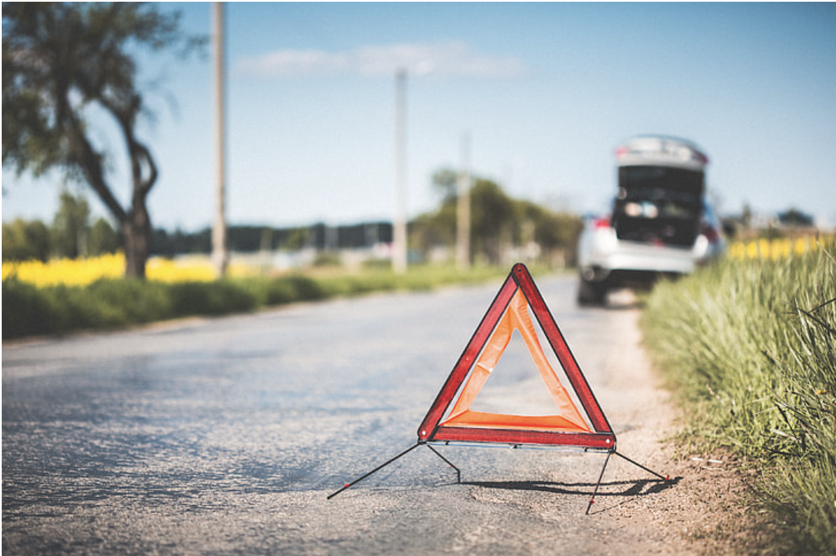


Predicting Severity of road accidents Elizabeth Kelley, Jack Wagner, Supriyo Ghosh, Tristan Freiberg
THE ERDŐS INSTITUTE
DATA SCIENCE BOOTCAMP, SPRING 2024
GitHub Repository

Slide 2
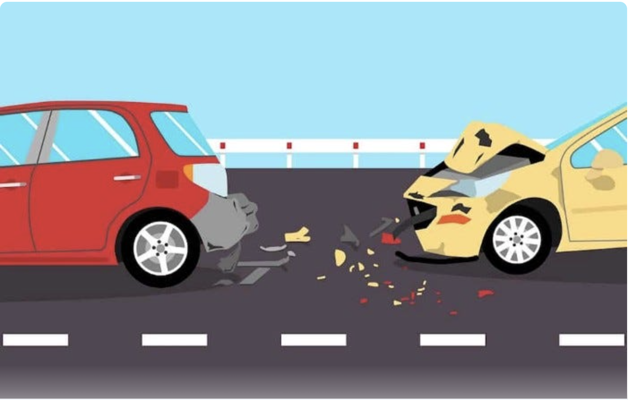
Introduction
Road accidents could be avoided or be less severe in certain conditions of the road
Factors such as human, road condition, vehicle, weather increases the chances of road accidents
Using these attributes powerful ML algorithms such as Random Forest, XGBoost can predict the chance of severity in a road accident
Play with the factors those are crucial in minimizing the chance of accident helps us provide recommendations

Slide 3
Data collection
We use the accident reports from QUEBEC AUTOMOBILE INSURANCE SOCIETY (SAAQ) for last 10 years.
Data from accident reports completed by police officers, including the time, severity of the accident as well as the type of vehicles involved.
Data obtained from SAAQ needed some cleaning and preprocessing.

Slide 4
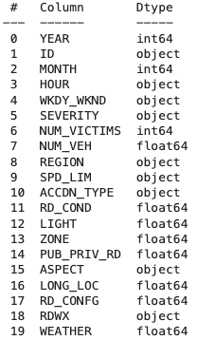
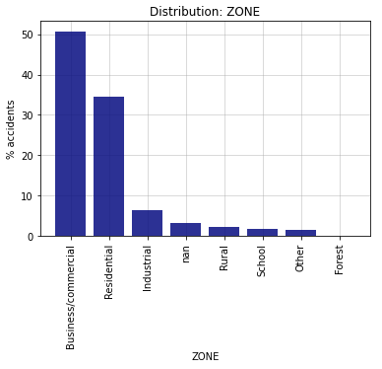
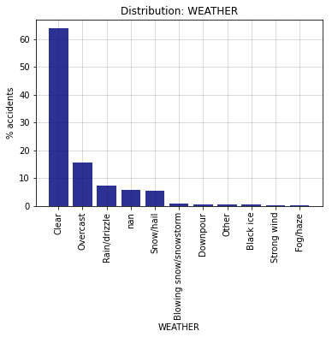
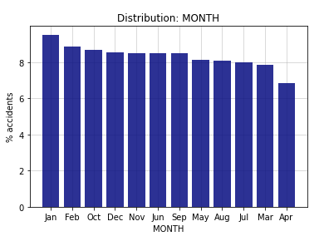
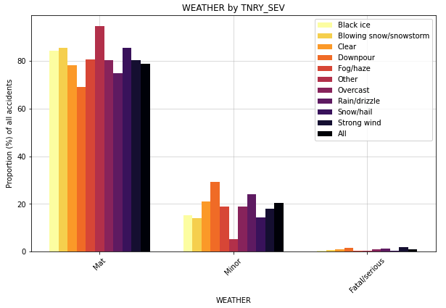
Data insights
Features

Slide 5
Models Used
Models used: Baseline, Logistic, Random Forest, SVM, XGBoost
Final model: XGBoost with upsampling
 | Predicted
Actual | 0 | 1 | 2 | Total
0 | 29598 | 7862 | 2092 | 39552
1 | 2555 | 4289 | 2744 | 9588
2 | 62 | 88 | 277 | 427
Total | 32215 | 12239 | 5113 | 49567
 | F2 score: 0.689

Slide 6
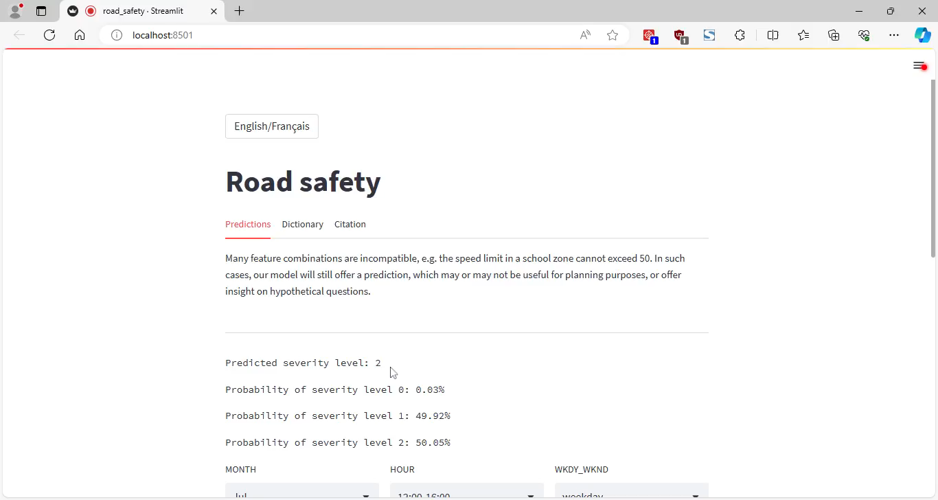
Streamlit application

Slide 7
Potential Future Directions
Test model on traffic data from different areas
Source traffic data with different variables to try to improve predictions
Create a tool for emergency vehicle dispatchers to allocate appropriate resources
Use model to make recommendations to city governments to improve areas with high accident severity

Slide 8
Acknowledgements
Our thanks to:
Dr. Adam Kawash, for his mentorship.
The Erdős Institute, for the opportunity and support!

